Slide 1

Seasonal Agriculture Performance Analysis
Student Name- Shusil Kumar nayak
College Name- Vignan Institute of Technology and Management
AICTE STU ID : STU698b4484f3ef31770734724

Slide 2

PROBLEM STATEMENT
Agricultural performance shifts across Kharif, Rabi and Zaid due to changing environmental conditions, farming practices, resource availability and market conditions
Raw agricultural data alone does not explain how or why performance changes from one season to the next
This project analyzes a 4,000-record seasonal agriculture dataset to uncover meaningful seasonal patterns, trends, relationships and variations
Goal: turn raw seasonal data into clear, evidence-based insights that support better agricultural planning

Slide 3
Project Description
Analyzes 4,000 farm records across 8 states, 8 crops and 3 seasons (Kharif, Rabi, Zaid) to understand seasonal agricultural performance
Covers the full data analytics workflow: data cleaning & preprocessing, exploratory data analysis (EDA), and seasonal, environmental, resource-usage and economic performance analysis
Applies statistical tests (ANOVA, Chi-square, correlation) to confirm which seasonal differences are genuine, not random
Uses visualizations (boxplots, bar charts, heatmaps) to compare yield, resource use and profitability across seasons, states and crops
Concludes with evidence-based insights and practical recommendations for seasonal agricultural planning

Slide 4

WHO ARE THE END USERS?
Farmers – to plan crop choice, timing and resource use season by season
Agricultural planners & government departments – to design season-aware agricultural policies and support programs
Agricultural analysts & researchers – to study seasonal performance patterns and build on these findings
Resource planners – to plan water, fertilizer and irrigation allocation across seasons

Slide 5

Technology Used
Python – core programming language for the analysis
Pandas & NumPy – data loading, cleaning and aggregation
Matplotlib & Seaborn – data visualization and charts
SciPy – statistical testing (ANOVA, Chi-square, correlation)
Jupyter Notebook – environment used to build and document the analysis

Slide 6
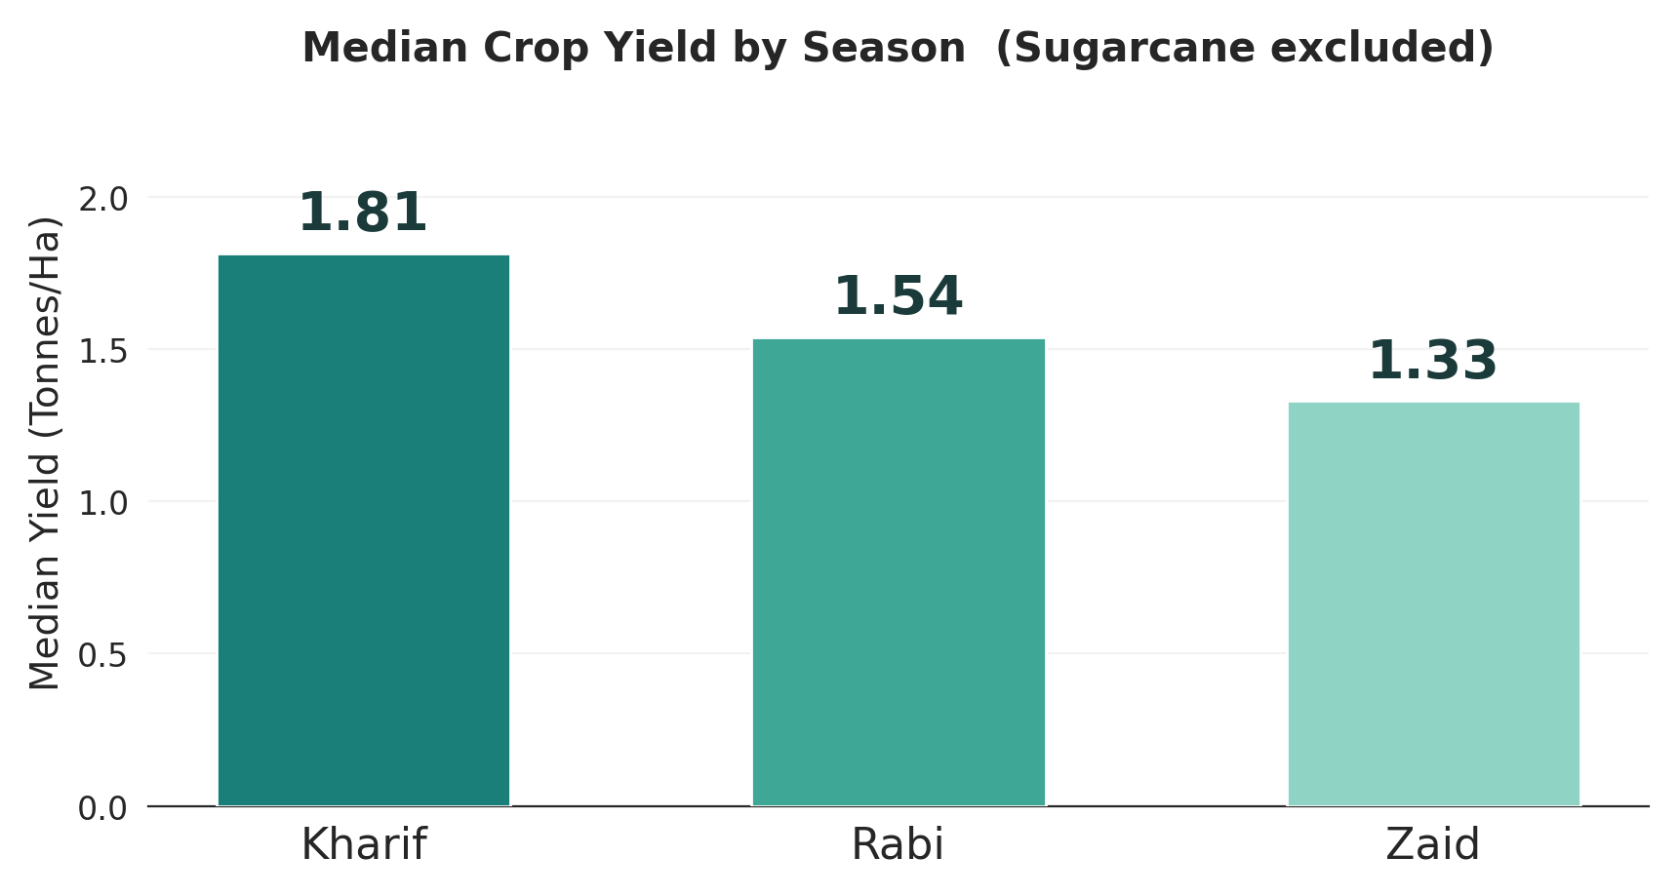
RESULTS
Kharif: 1.81 t/ha (highest)
Zaid: 64.5% of farms in loss

Slide 7
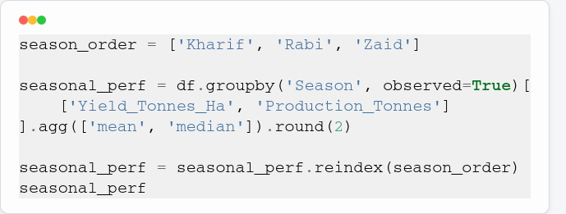
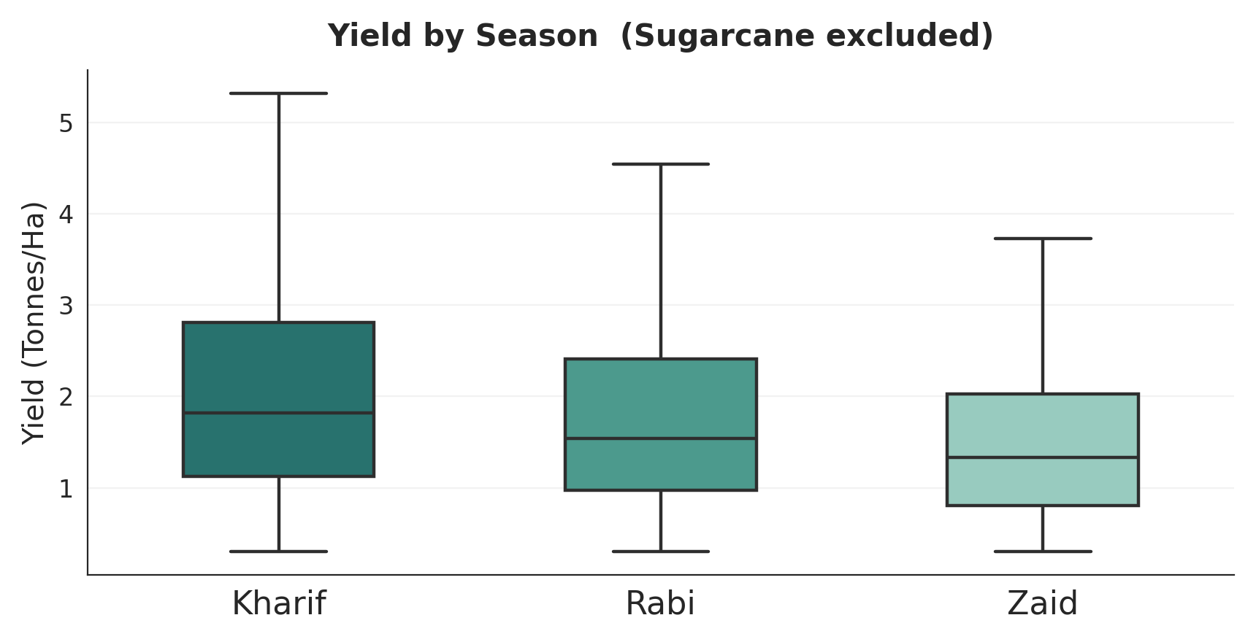
RESULTS
Seasonal Yield Comparison
Rice ANOVA: p < 0.001

Slide 8
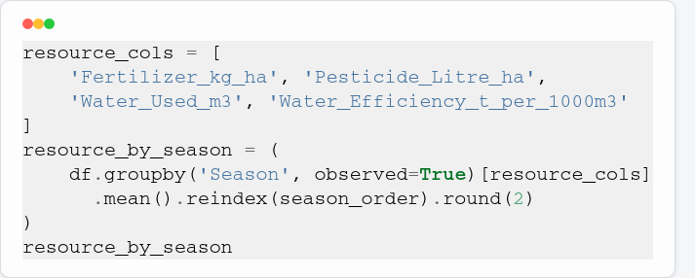
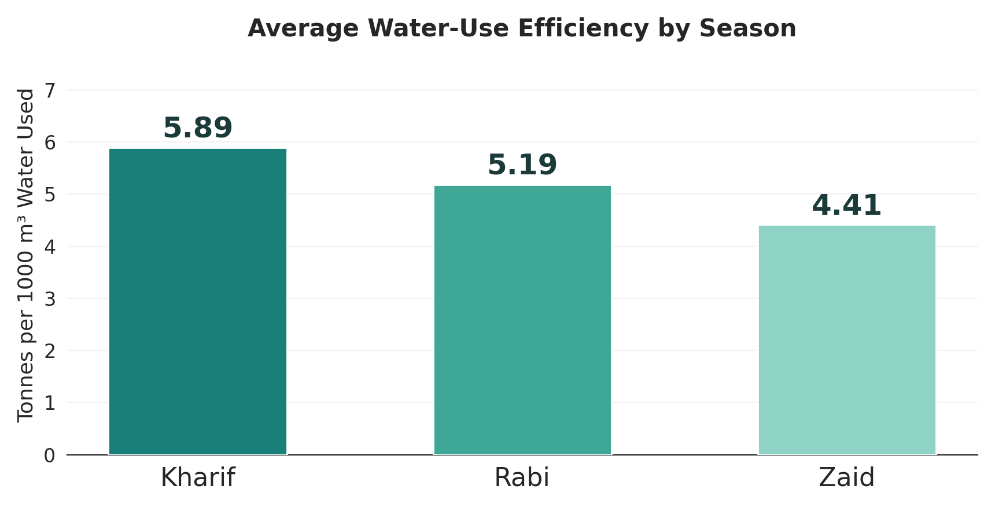
RESULTS
Water Use vs Efficiency
Zaid: high use, low efficiency

Slide 9
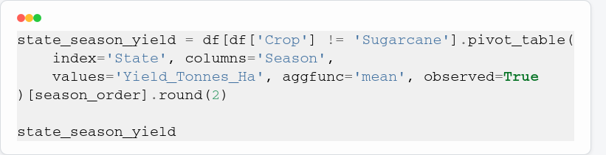
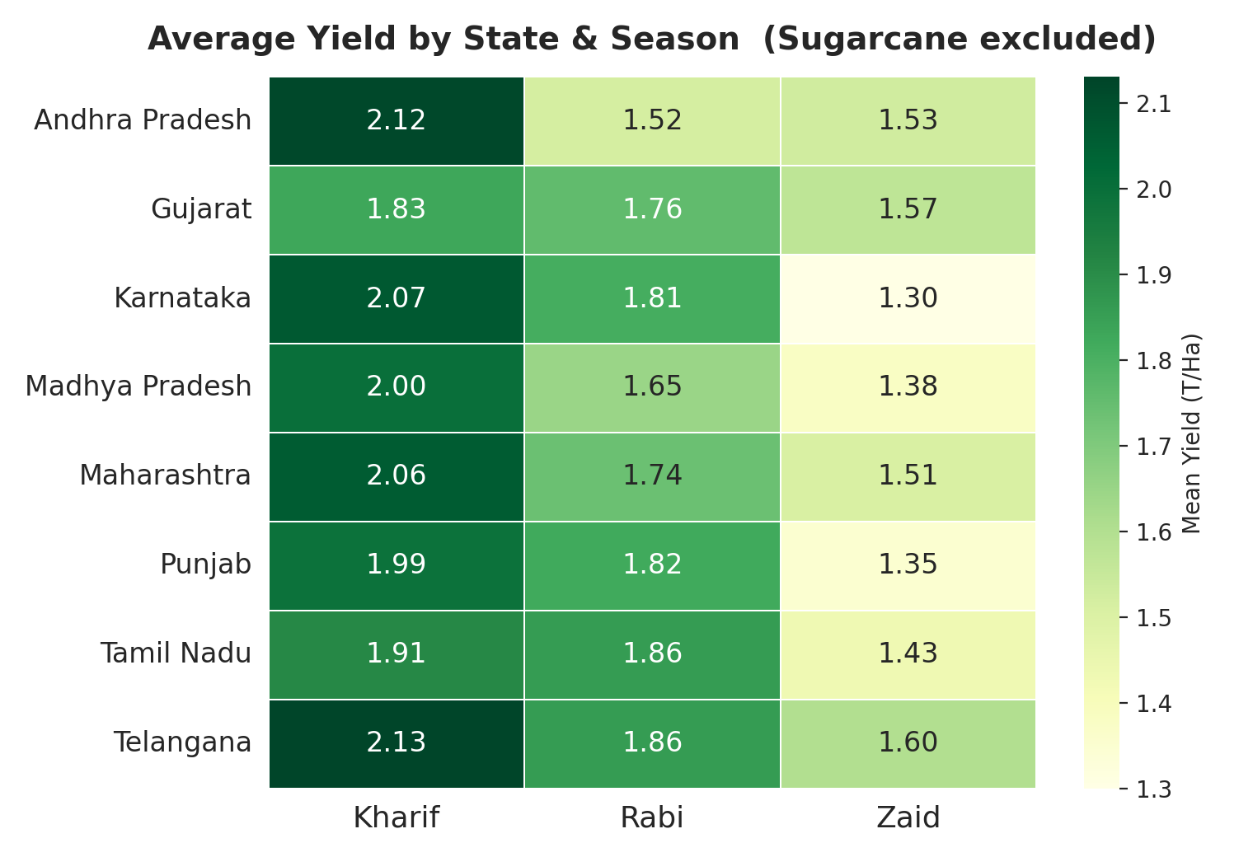
RESULTS
Yield by State & Season
Kharif leads most states

Slide 10
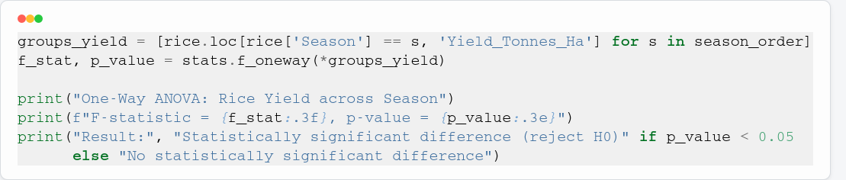
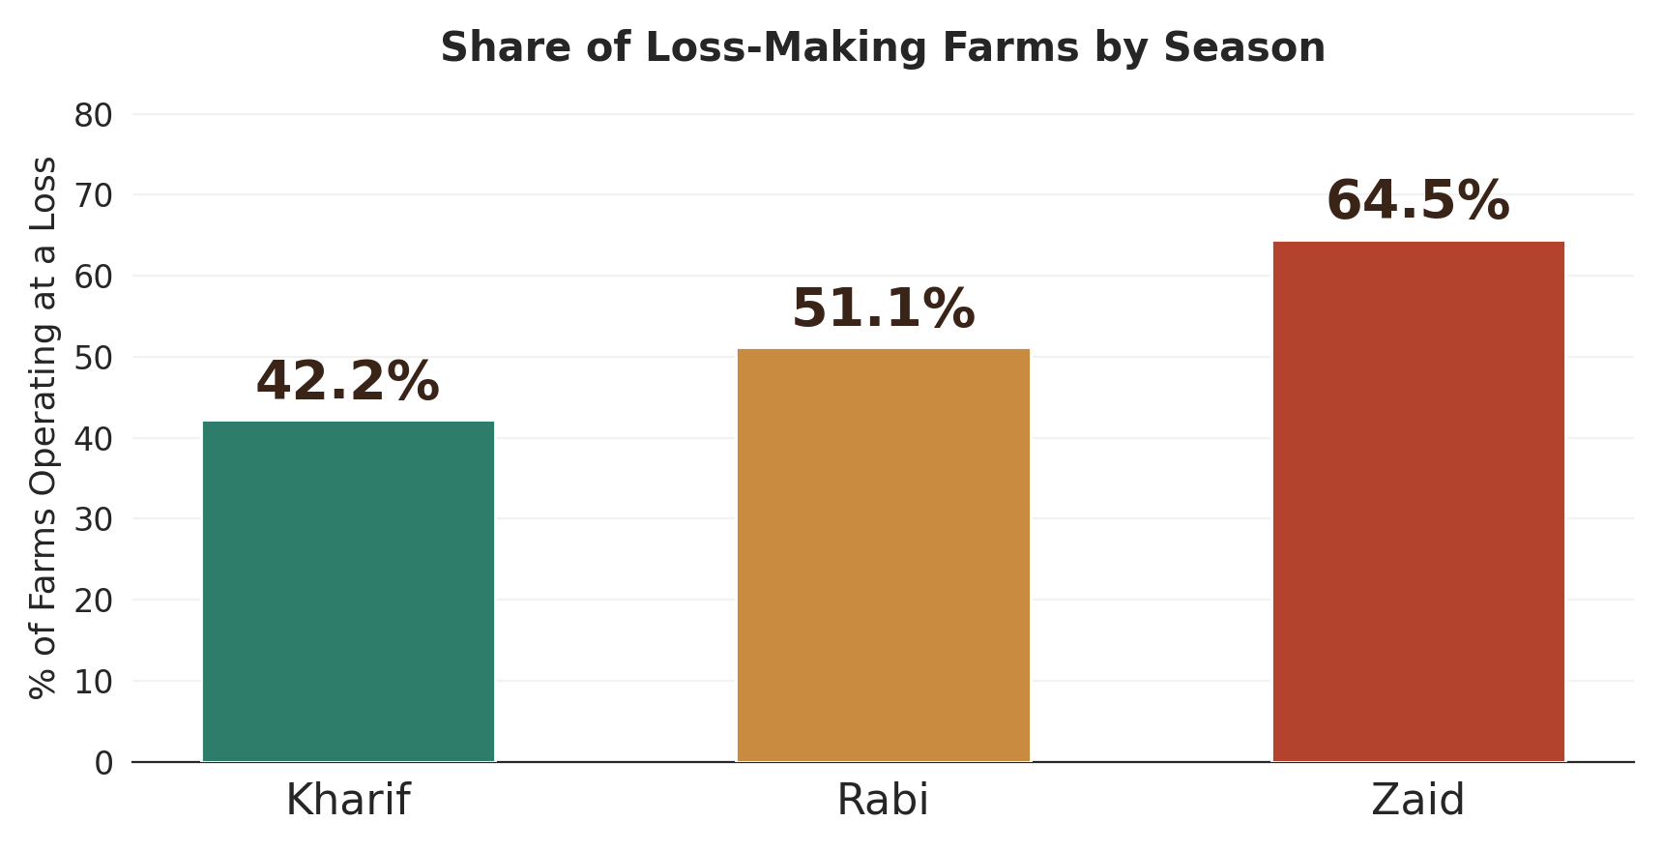
RESULTS
Profit & Loss by Season
Only Kharif profit is positive

Slide 11
Future scope
Data & Modeling
Planning & Optimization
Larger, multi-year datasets for stronger seasonal trend analysis
Integration of real-time weather and soil-sensor data
Predictive yield-forecasting models
Crop recommendation system by season and region
Resource (water, fertilizer) optimization tools
Extension to more states, crops and seasons

Slide 12
GitHub Link
[https://github.com/Shusil132/Project_Seasonal_Agriculture_Perfomance_Analysis ]

Slide 13

VOIS Course completion certificate - Course name- Data Visualization

Slide 14
Thank you

